Slide 1
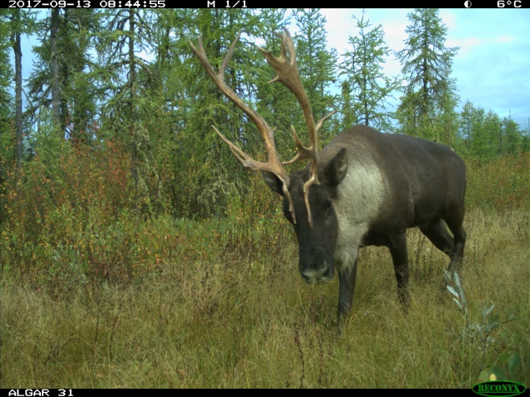
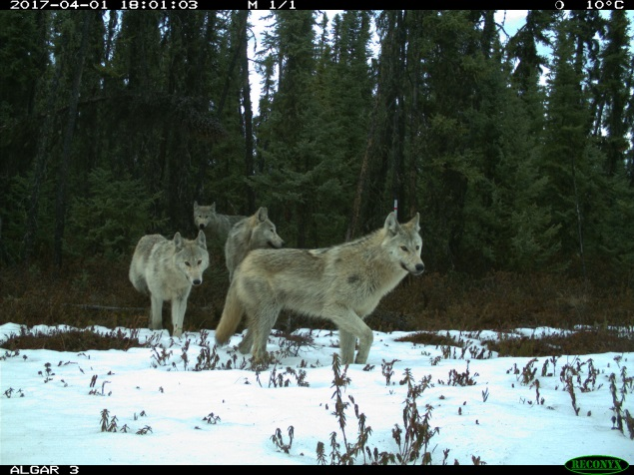
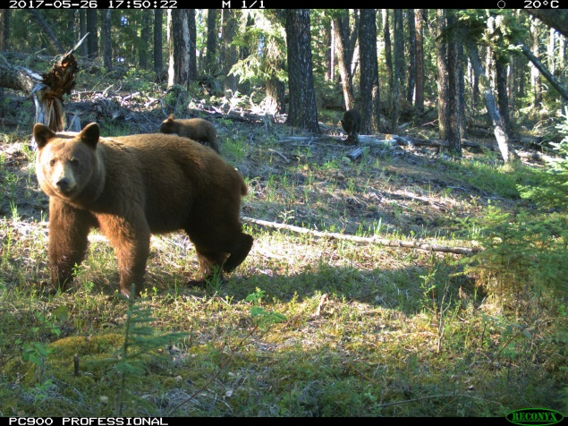
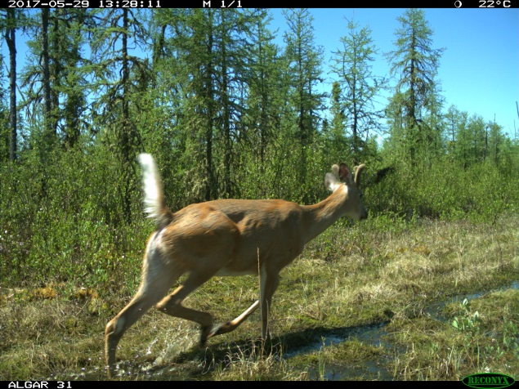


It takes a community: strategies for caribou conservation from a multi-species perspective
Erin Tattersall, Joanna Burgar, Jason Fisher, & Cole Burton
ACTWS, March 2018
@erin_tatt
ertattersall@gmail.com
Notes:
Hi, I’m Erin and I’m a Master’s student at UBC. Today I’ll be talking about the first results from my thesis research, but before doing that I’d like to acknowledge that we are standing within Treaty 7 territory, traditional territory of the Niitsitabi, Nakoda, and Tsuut’ina First Nations, and that this research is taking place within Treaty 8 territory.

Slide 2
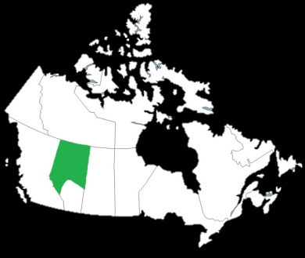
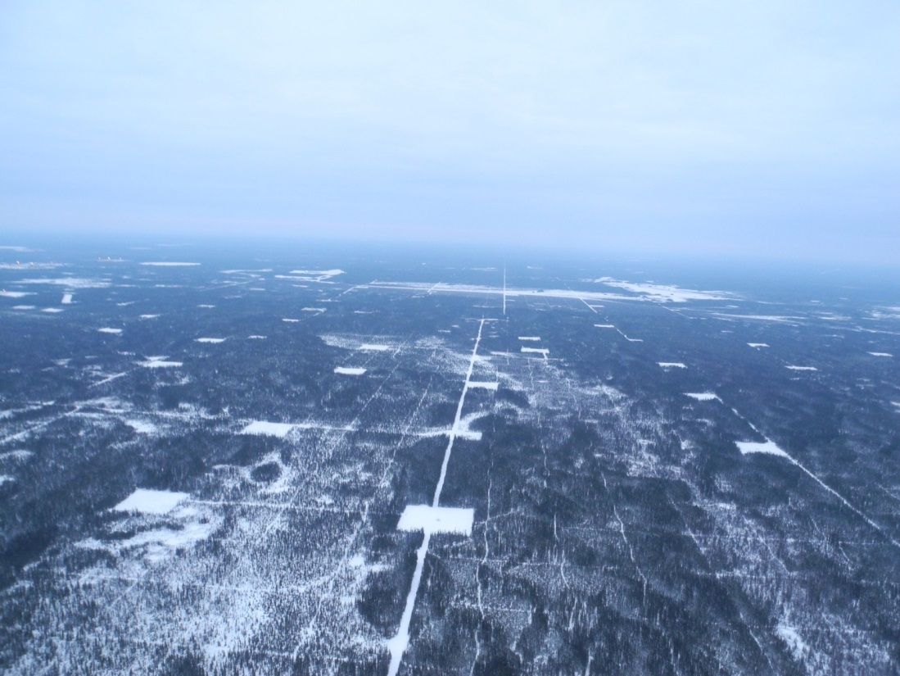
Alberta’s energy development
~170 000 km of linear disturbance in the boreal forest (Komers & Stanojevic, 2013)
Slow to regenerate in lowland forest areas (van Rensen et al., 2015)
Alter configuration of landscape patches (Pickell et al., 2016)
Notes:
This photo is showing a disturbance I know many of you are familiar with, which are legacy seismic lines cut by the energy industry for oil exploration. I remember first coming across seismic lines as a treeplanter in northern Alberta, and being astounded by how they seem to stretch on forever. There are over 170 000km of linear corridors in Alberta’s boreal forest, and seismic lines make up the majority of those. They are widespread, and studies by Cassidy van Rensen and others show that they are slow to regenerate and can persist on the landscape for upwards of 50 years. Seismic lines change landscape configuration, which can have significant effects on the boreal mammal community
Legacy seismic lines, around 6m wide (4-8m)

Slide 3
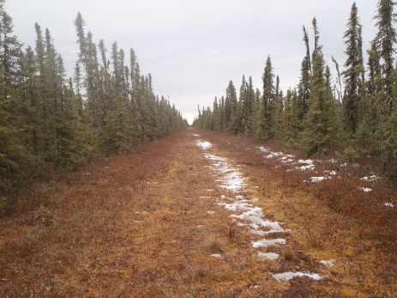
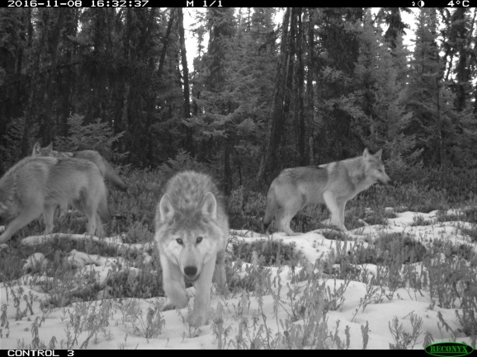
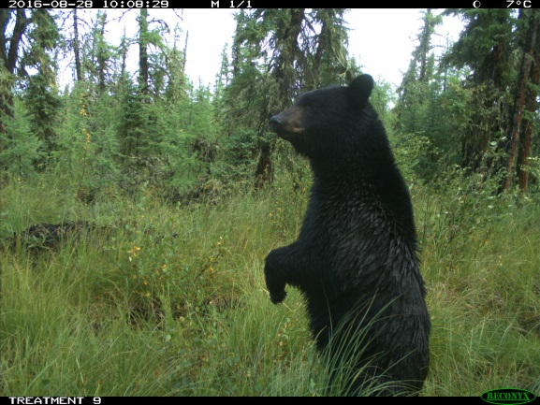
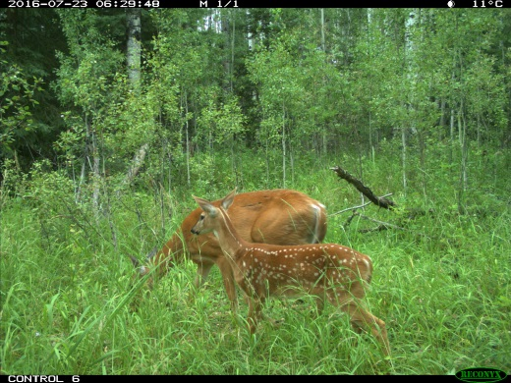
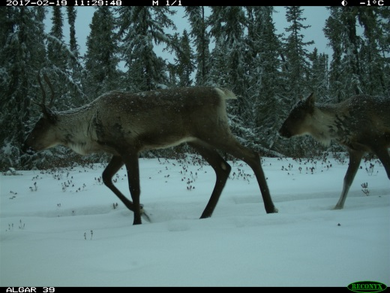
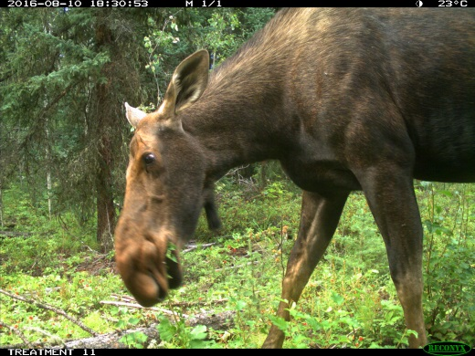
Community impacts of disturbance
J. Burgar
Boutin et al., 2012; Dickie et al., 2016; Latham et al., 2011; Latombe et al., 2014; Tigner et al., 2014
Notes:
Specifically, a number of studies out of the University of Alberta have shown how seismic lines are altering predator- prey dynamics. With an increase in industrial development in the boreal forest, herbivores like white-tailed deer and moose have increased in number and changed their habitat selection, which in turn increases the number of grey wolves. Seismic lines also create movement corridors for predators like wolves and black bears, all of which is bad news for woodland caribou. Caribou are therefore experiencing severe habitat fragmentation from development, as well as increased predation rates via apparent competition with deer and moose.

Slide 4
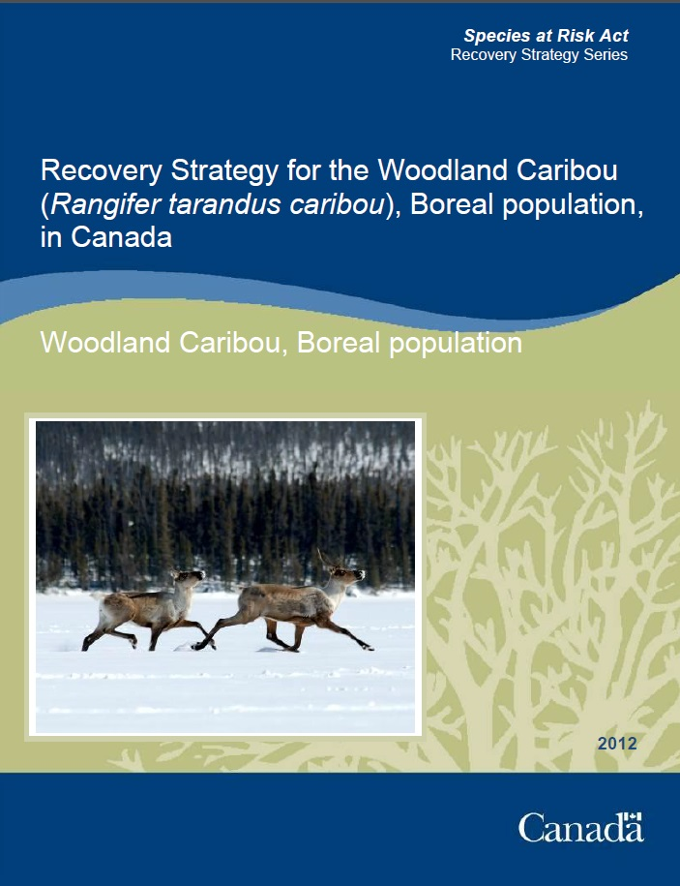
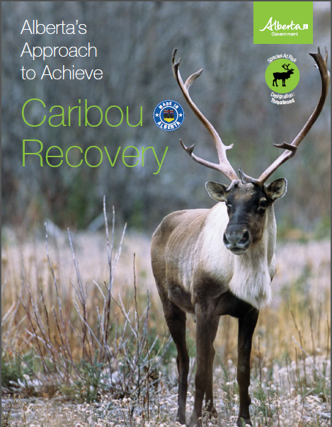
Restoration for caribou conservation
Calls for critical habitat conservation (minimum %65 undisturbed)
Seismic line treatments for integrated land management
- Restoration of legacy lines
- Multi-use corridors
Treatments may have community-wide effects
- mitigate harmful interactions for caribou
Environment Canada, 2012; AEP, 2017
Notes:
As many of us know, woodland caribou are protected under SARA, and a robust regulatory framework exists to address threats facing caribou.
Environment Canada’s 2012 recovery strategy set a minimum habitat threshold of 65% undisturbed habitat, and Alberta’s 2017 draft range plan sets targets for specified line treatments that allow for caribou conservation on a working landscape. This will include restoration of legacy seismic lines to reach that 65% threshold, as well as leaving multi-use corridors for ongoing industry activities.
What’s important to note about this approach is that it will affect numerous species within the boreal mammal community, not just caribou. In influencing other boreal mammals, there is the potential to mitigate the harmful interactions they have with caribou.

Slide 5
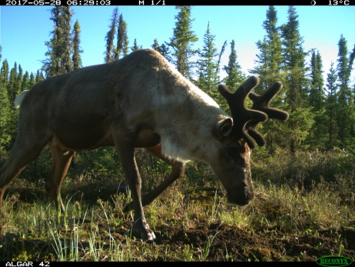
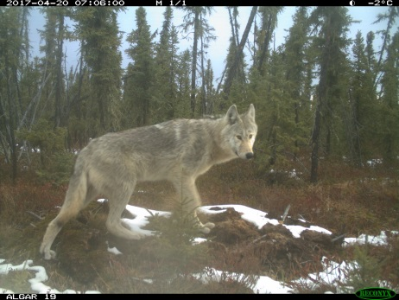
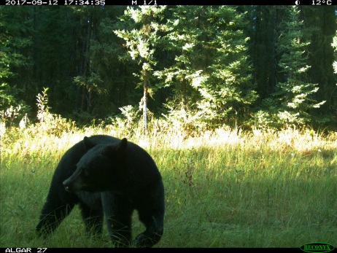
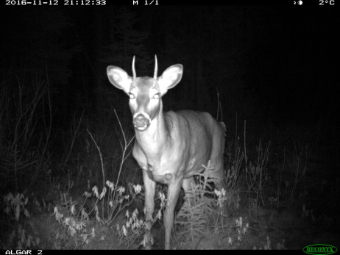
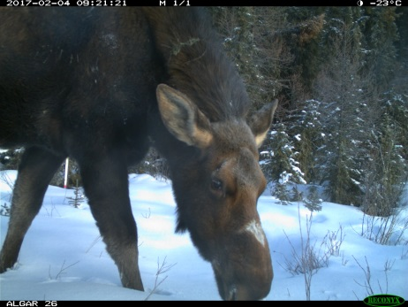
Research question
Does seismic line treatment affect use of lines by large boreal mammals?
Caribou
Rangifer tarandus
Caribou Predators
Caribou Competitors
Canis lupus, Ursus americanus
Odocoileus virginanius, Alces alces
Notes:
This of course, leaves room for a very important research question: does seismic line treatment (whether it is restored, regenerating, or used in other ways) actually change line use of large boreal mammals? In particular, I am interested in line use by caribou, predators like wolves and black bears, and caribou competitors like white-tailed deer and moose.

Slide 6
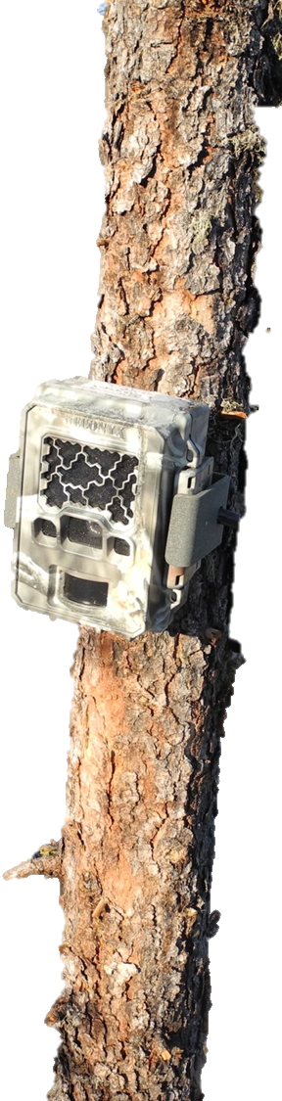
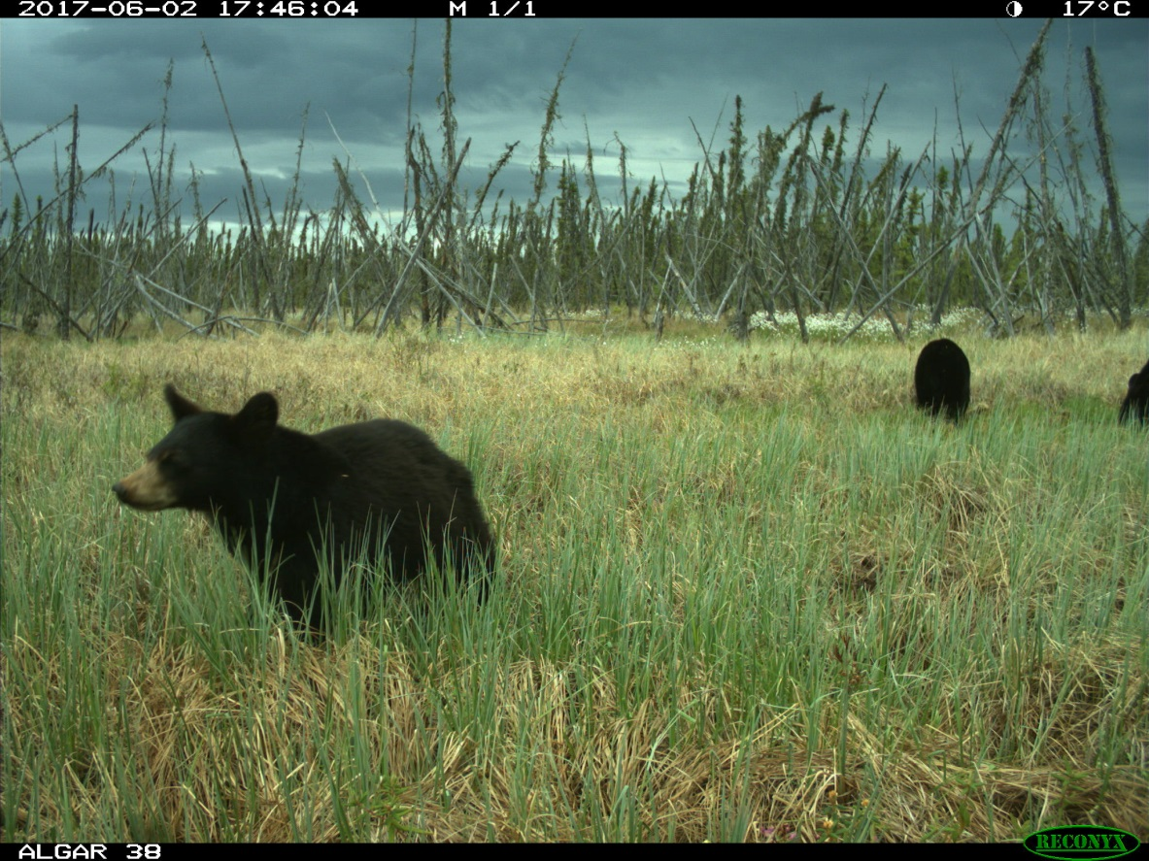
Methods: Camera trapping
Notes:
And to investigate this question, I am using remote camera traps, which allow for non-invasive, long term monitoring of multiple species

Slide 7
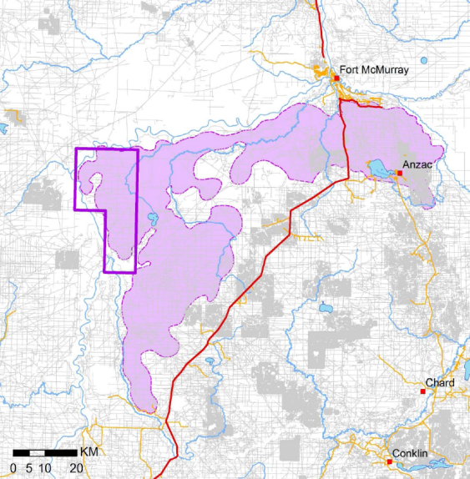

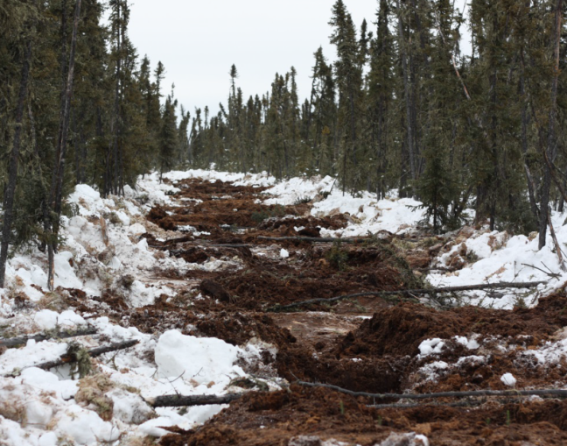
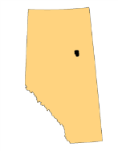
Algar Caribou Habitat Restoration Program
70 km southwest of Fort McMurray, AB
Restoration via Site Preparation and Planting (SPP)
Restored 3-6 years ago (winters of 2012 – 2015)
Burton, 2015; Silvacom & Nexen, 2015
Notes:
We’ve paired with the Algar Caribou Habitat Restoration Program, located within the Algar caribou herd range on the East Side of the Athabasca River. This program involved restoring seismic lines through site preparation and planting, where they created mounds of rich mineral soil and replanted them with black and white spruce seedlings. This is meant to create movement barriers and facilitate vegetative regeneration of caribou habitat. Restoration was completed between 3-6 years ago, so my research is really looking at the short term effects of restoration on large boreal mammals.

Slide 8
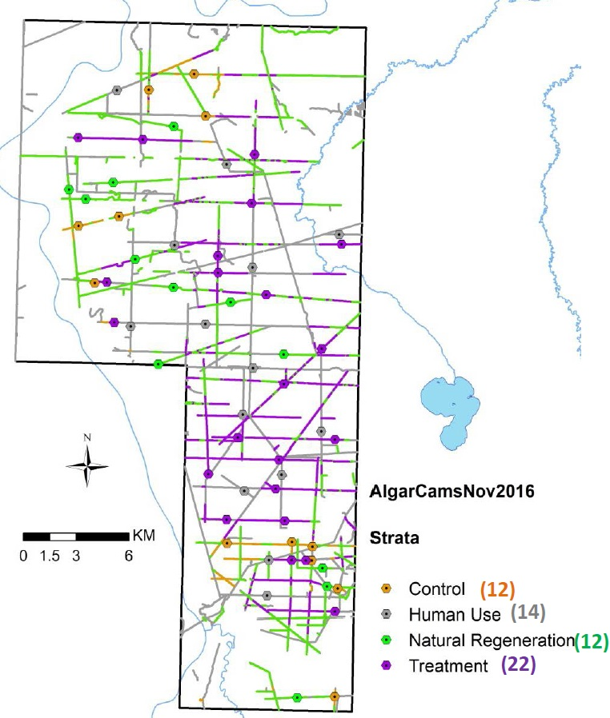
Sampling design
60 camera traps across 4 seismic line treatments:
Nov. 2015: 24 cameras deployed (12 Control, 12 Site Prep. Plant)
Nov. 2016: 36 cameras deployed (10 SPP, 14 Human Use, 12 Natural Regeneration)
Control (12)
Human Use (14)
Nat. Regen. (12)
Site Prep + Plant (22)
Burton, 2016
Notes:
We currently have 60 camera traps deployed across the Algar landscape: the first 24 were deployed in Nov 2015, followed by an additional 36 a year later. There actually 4 different seismic line treatments we look at, as shown by this map of lines and camera locations. There are lines that have undergone site preparation and planting or SPP (shown in purple), lines that were thought to be sufficiently regenerating naturally (shown in green), lines that were left unrestored as controls (shown in yellow), and lines that were set aside for human use (shown in grey).

Slide 9
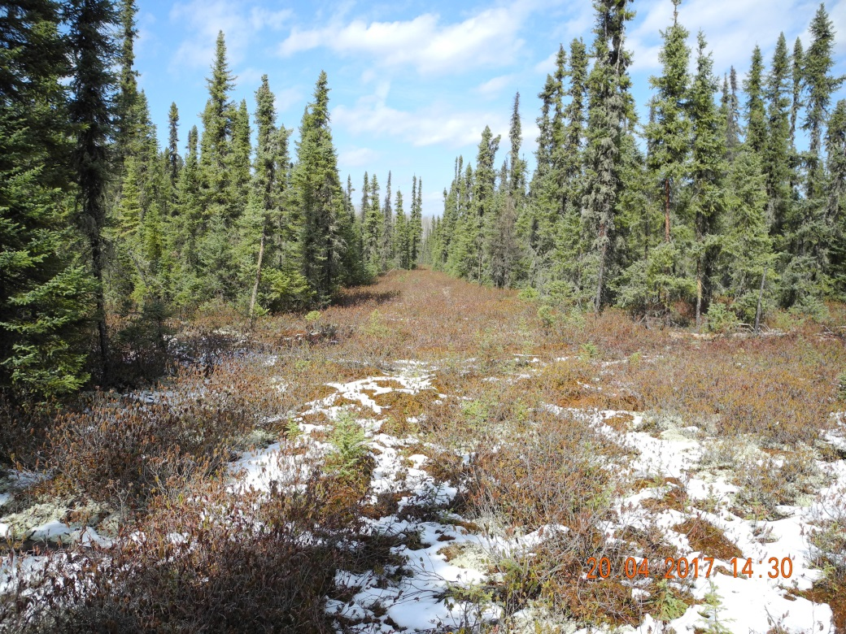
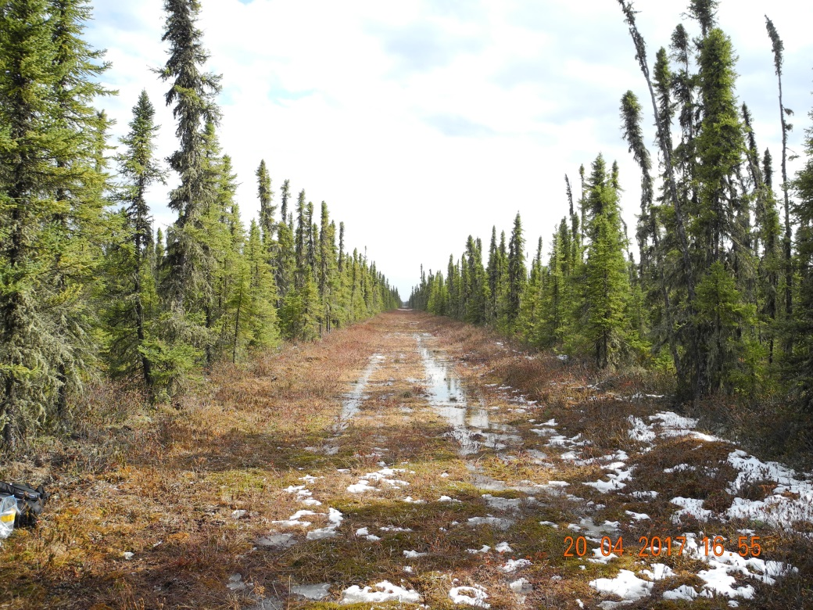
Seismic line treatments
Control
Human Use
Notes:
These are what the lines look like on the ground. There’s the Control lines that haven’t been replanted but are not regenerating on their own, and Human Use line that are left available for industry and trapping activities.

Slide 10
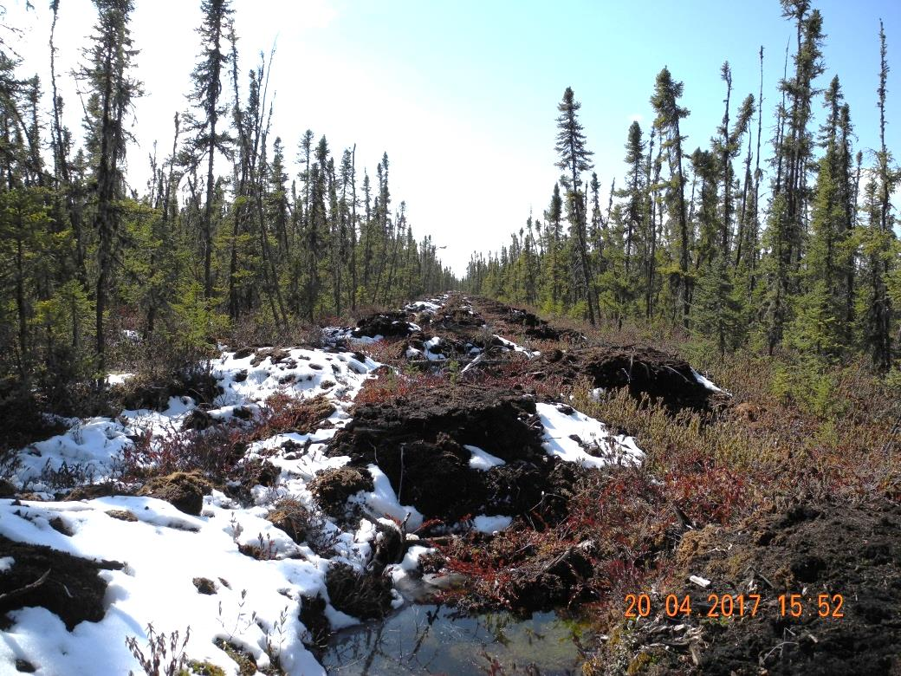
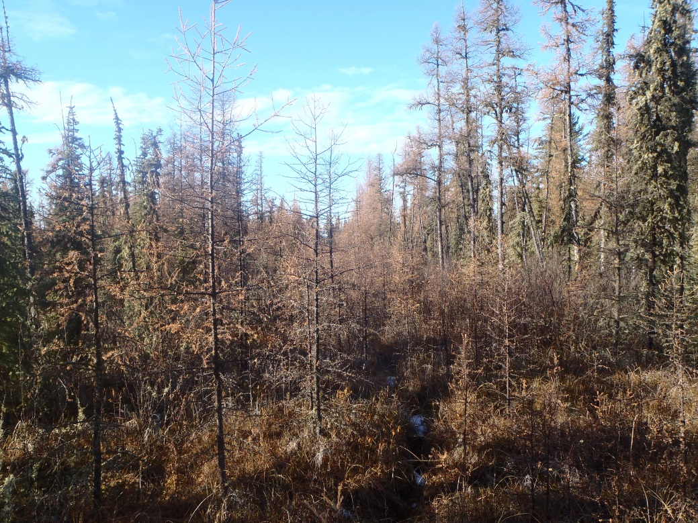
Seismic line treatments
Site Prep + Plant
(SPP)
Natural Regeneration
(NatRegen)
Notes:
Then there’s the Site Preparation Plant lines, distinctive with mounding and replanted seedlings, and finally natural regeneration lines, with at least 1.5m of vegetation.

Slide 11
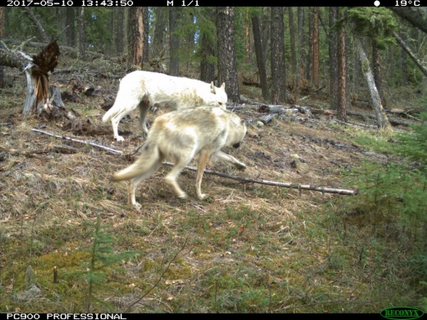
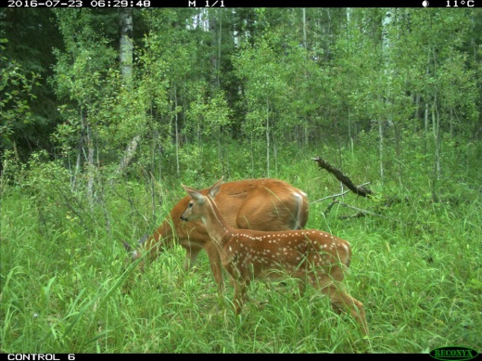
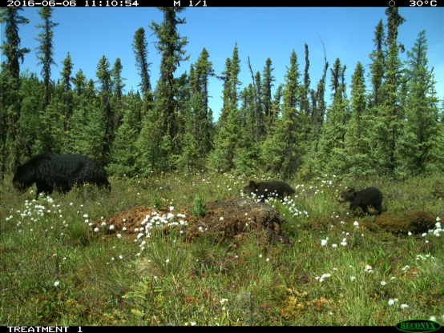
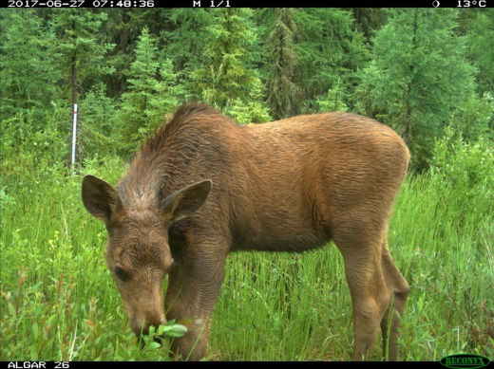
Hypotheses: responses to treatment
Notes:
I quantified line use for different species in terms of camera trap detections across these 4 line types. If seismic line regeneration does create movement barriers for predators such as wolves and black bears, we should see fewer detections of these predators along regenerating lines like SPP and NatRegen. We might expect the same pattern for deer and moose as regeneration replaces their early seral forage with other vegetative species.

Slide 12
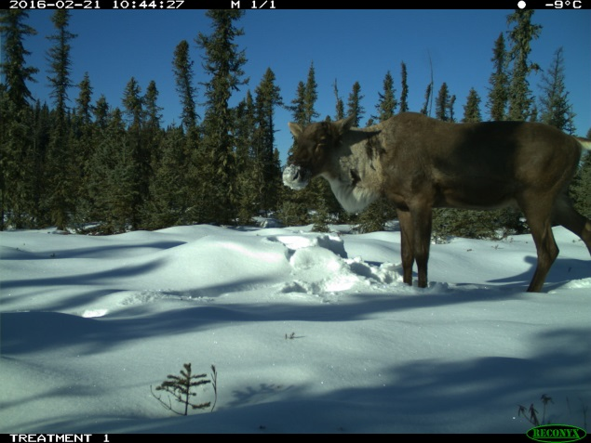
Hypotheses: responses to treatment
Notes:
Conversely, if regenerating seismic lines have fewer predators and competitors on them, then I hypothesize that caribou detections will increase on these lines, resulting in the opposite pattern.

Slide 13
Analytical approach
Zero Inflated Generalized Linear Mixed Models
monthly species detection rate ~ β₀
+ β₁ (seismic line treatment) + β₂ (% lowland) + β₃ (snow days per month)
+ β₄ (vegetation height) + β₅ (seismic line treatment * % lowland)
+ (1|site)
+ (1|month)
Notes:
To test these hypotheses, I’m modelling them within a generalized linear mixed model framework. My response variable is the number of species detections per month, modeled as a function of seismic line treatment. I’m also including covariates for % lowland habitat (preferred by caribou), snow days per month (accounting for season), vegetation height (addressing movement barriers on the line).
Finally, I’m including mixed effects for site and month to account for heterogeneity of variance. I used these covariates to create a number of possible combinations, then performed model selection with AIC.

Slide 14
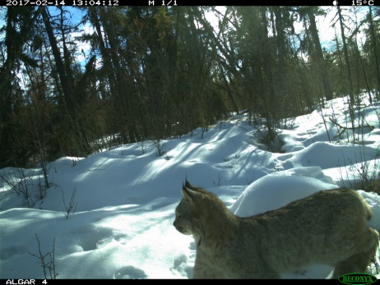
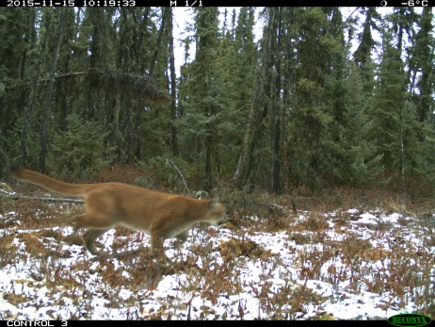
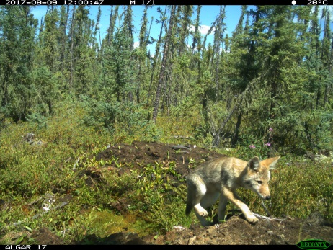
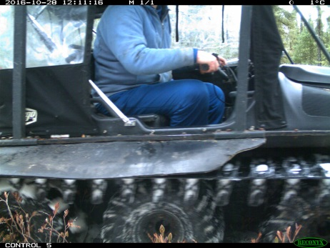
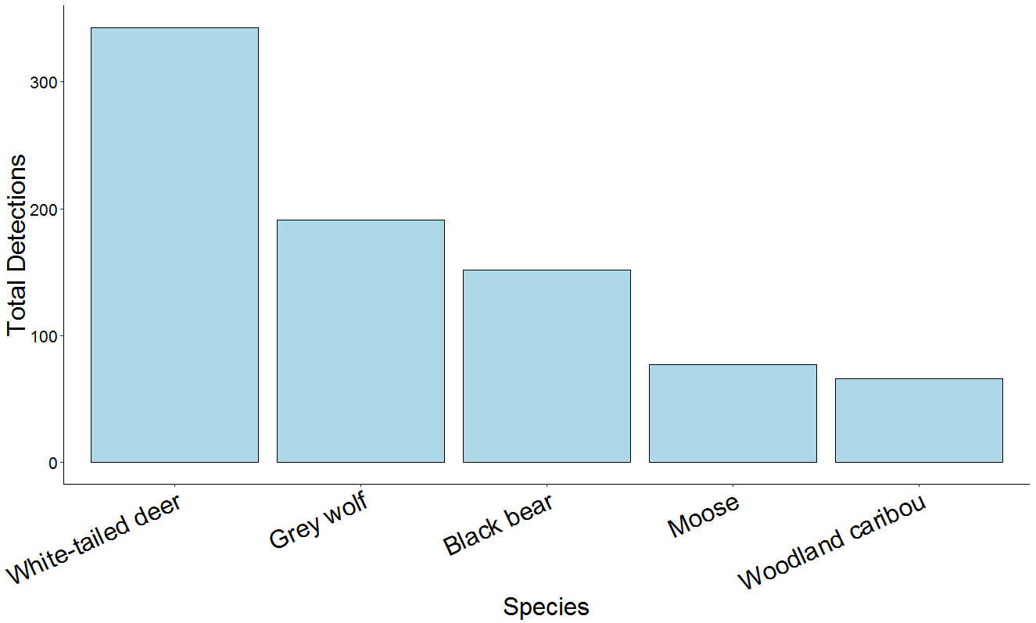
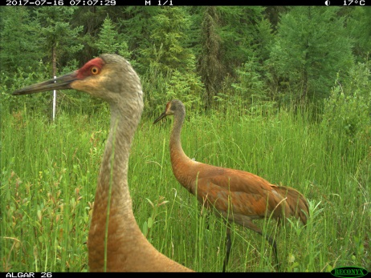
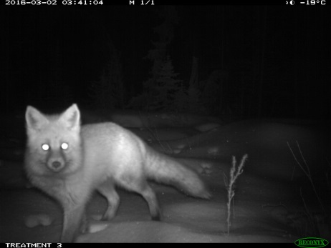
Results: Species detected Nov. 2015 – Apr. 2017
343
191
152
77
66
Notes:
To begin my data analysis, I modeled these for species detections during our first 2 camera deployments, between November 2015 and April 2017. This graph is showing the total number of detections for my five target species, but it’s worth noting that the cameras pick up many other members of the boreal community, as shown in these photos.

Slide 15
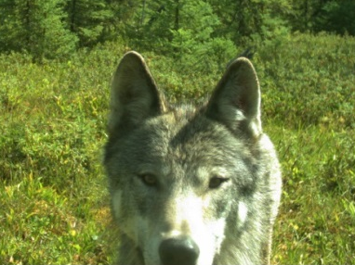
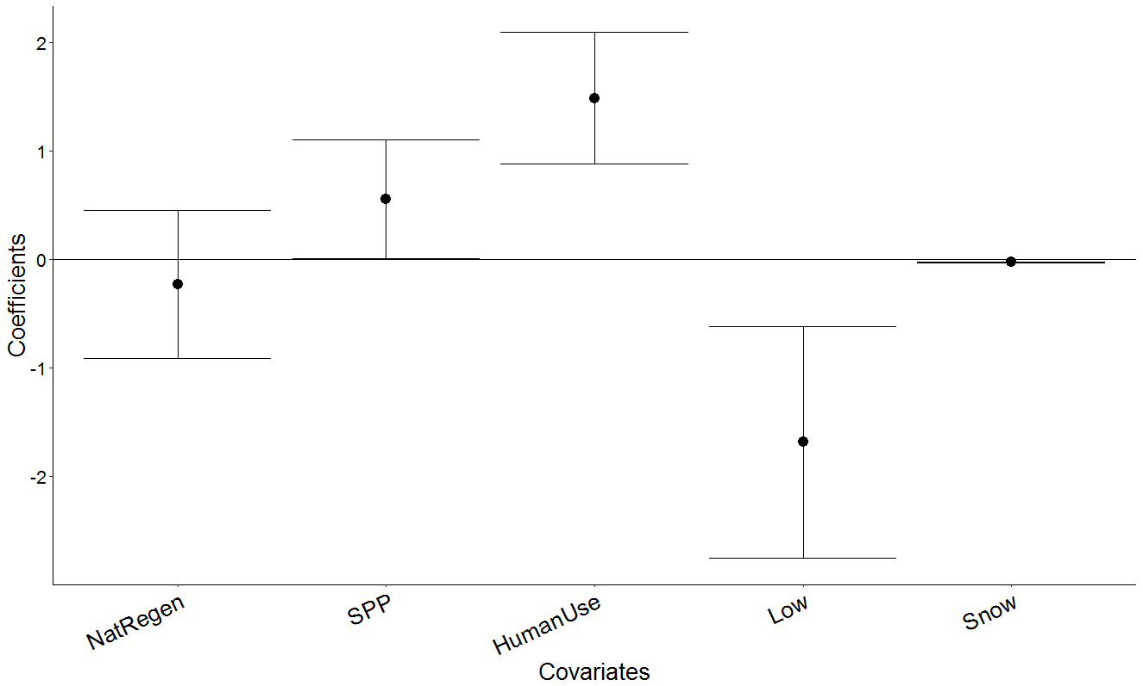
More wolves on human use lines
Wolf ~ Treatment + %Lowland + SnowDays + (1|Site) +(1|Month)
Notes:
Let’s start with wolves. Among my top 3 models with similar model weights was this one including treatment, %Lowland, and SnowDays, indicating that all 3 of these covariates have an effect on wolf detections. This is a plot showing parameter estimates and standard error for each covariate in the model. Here we see that human use lines seem to have a relatively strong positive effect on wolf detections, while lowland habitat has a negative effect, and snow has a slight negative effect.
Human use est: 1.5
Low est :-1.7
Snow: -0.02

Slide 16
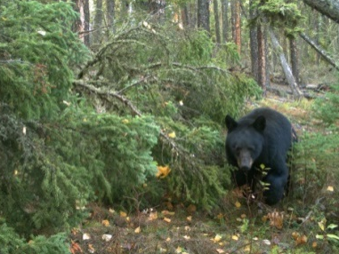
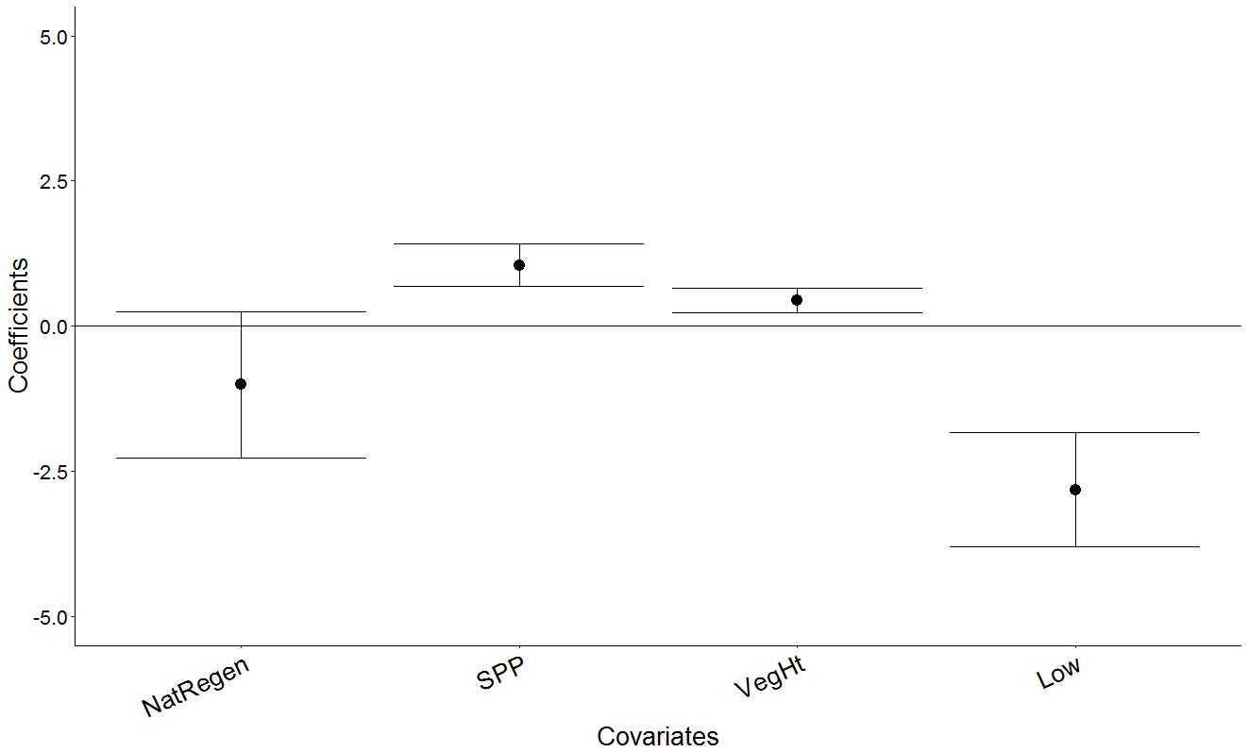
More bears on SPP lines April - October
Blackbear ~ Treatment + VegHt+ %Lowland + (1|Site) + (1|Month)
Notes:
For black bears, I used a truncated survey period to only include months between April and October, when bears are active. My top model was one that included treatment, vegetation height, and lowland habitat.
In this plot I’ve removed Human Use due to low sample size in this time period, but we can see that Site Prep plant lines and VegHt have slight positive effects on bear detections, while lowland habitat has a negative effect.
Removed human use → no detections on human use lines
SPP est: 1.05
VegHt: 0.4
Low: -2.8

Slide 17

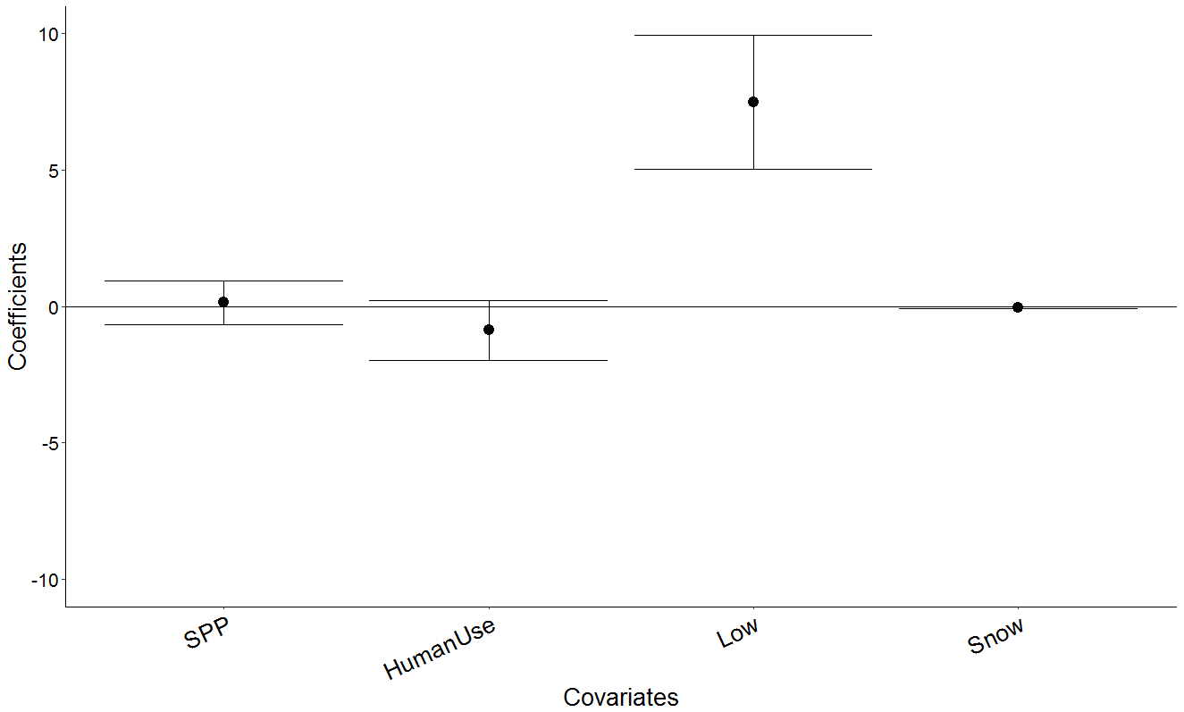
More caribou in lowland forest
Caribou ~ Treatment + %Lowland + Snow Days + (1|Site) + (1|Month)
Notes:
Next, we come to caribou. Caribou detections seemed to be best explained by the proportion of lowland habitat, but again, this model was closely followed by models including Treatment with only slightly less weight.
Looking at parameter estimates for the top treatment model, we see that lowland habitat does have a strong positive effect on caribou detections. For treatment effects, we see that Human Use lines have a slightly negative effect on caribou, but not much. Comparing detections directly shows that there does seem to be increasing detections with restoration. And it’s worth addressing that in the 6 months the Nat Regen cameras were active, there were only 2 caribou detections, so for clarity I’ve removed the NatRegen coefficient from my plot.
Low: 7.8

Slide 18
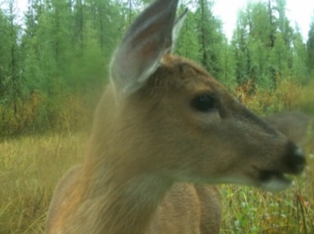
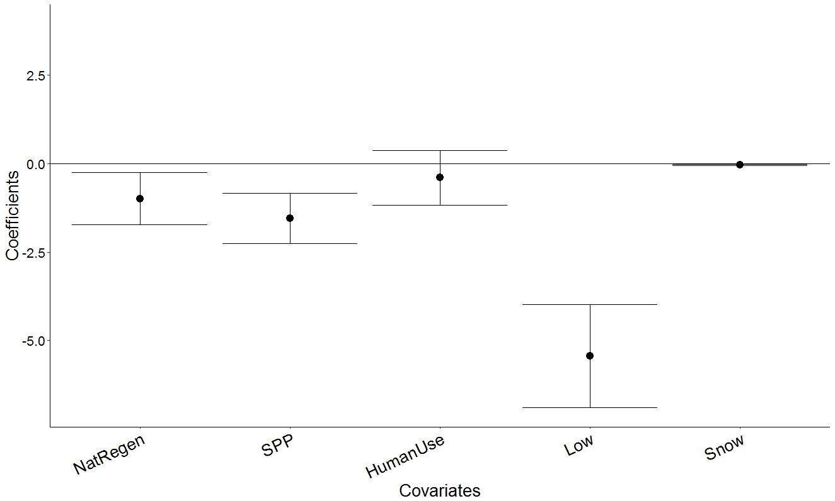
Fewer WT deer on regenerating lines
WTDeer~ Treatment + %Lowland + Snow Days + (1|Site) + (1|Month)
Notes:
Moving on to caribou competitors, the top model was again one that included Treatment, lowland habitat and snow, which had significantly more weight attributed to it compared to other models.
If we look at the parameter estimates in detail, we see ‘fairly decent’ negative effects of natural regen and SPP lines, and a strong effect of lowland habitat. The treatment effects are also evident when comparing detections across line types, where we see quite a few more deer detections on control lines compared to others.
LRT test with Treatment + Snow Days = significance with 0.0001184
NatRegen: -1
SPP: -1.5
Low: -5.4
Snow: -0.03

Slide 19
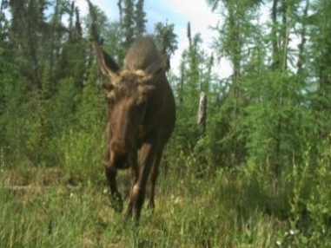
Moose: further analyses needed…
Model Name | dLogLik | dAIC | df | Model weight
Null | 0.0 | 0.0 | 4 | 0.2889
VegHt | 0.9 | 0.2 | 5 | 0.2595
%Lowland | 0.3 | 1.4 | 5 | 0.1427
Snow | 0.0 | 2.0 | 5 | 0.1084
Treatment + VegHt | 2.5 | 3.0 | 8 | 0.0645
Treatment | 1.0 | 4.0 | 7 | 0.0385
Treatment + %Lowland + VegHt | 3.0 | 4.1 | 9 | 0.0373
Treatment + %Lowland | 1.2 | 5.7 | 8 | 0.0169
Treatment*%Lowland | 4.1 | 5.8 | 11 | 0.0158
Treatment + %Lowland + VegHt + Snow | 3.0 | 6.1 | 10 | 0.0138
Treatment + Snow | 1.0 | 7.3 | 9 | 0.0074
Treatment + %Lowland + Snow | 1.2 | 7.7 | 9 | 0.0063
Notes:
Last, and in this case least, we come to moose. So far I’ve only gotten my moose models to run without zero inflation, and of those the models with the most explanatory power are the null models

Slide 20





Conclusions
Species | Predicted change with regeneration | Hypotheses supported?
 |  | Somewhat
 |  | No
 |  | Somewhat
 |  | Yes
 |  | N0
Notes:
To sum all of those up, let’s compare my results to my original hypotheses. I predicted that regeneration would lead to a decrease in detections for wolves, black bears, deer, and moose, and an increase in detections for caribou. Wolf detections were higher on HU lines, but also higher on Site prep plant, so this hypothesis is only slightly supported. Black bear detections were actually positively affected by SPP, so that hypothesis is not supported. Caribou detections were only slightly lower on HU lines with little difference across other treatments, so that one is only somewhat also. For deer we saw fewer detections on SPP and Nat Regen, so we have evidence to say yes, regeneration decreases deer use of lines. And for moose, right now we have no clear answers (they’re doing whatever they want).

Slide 21
Conclusions
Does seismic line treatment affect use of lines by large boreal mammals?
Yes
Caribou
Rangifer tarandus
No
Caribou Predators
Caribou Competitors
Canis lupus, Ursus americanus
Odocoileus virginanius, Alces alces
Notes:
Relating back to my original research question, seismic line treatment does affect line use by large boreal mammals,
and that restoration is having the predicted effect on caribou competitors even in the short term.

Slide 22
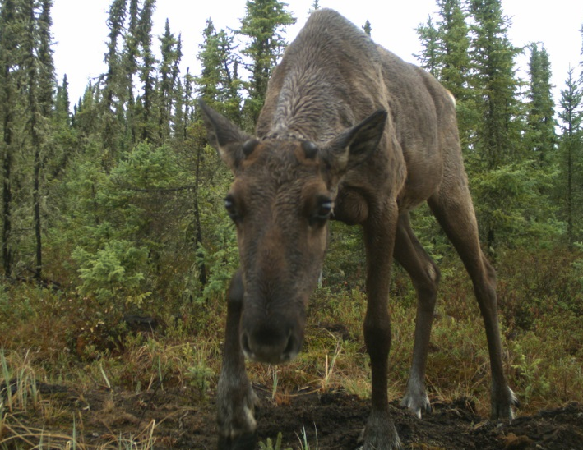
Summary
Linear disturbances alter community interactions at the expense of caribou
Seismic line treatments suggest potential for integrated land management
Caribou conservation via altered community interactions
Multi-species monitoring informs conservation efficacy and community impacts
@erin_tatt
ertattersall@gmail.com
Notes:
It’s early days yet, but this suggests that over time this could lead to spatial segregation between caribou and their predators and competitors, thereby reducing some of those negative community interactions.
It also provides support for an integrated land management approach to caribou conservation, where human activities on lines is actively managed to balance economic and conservation interests.
Finally, these results stress that when monitoring restoration for efficacy, we need to focus on strategies that allow for multi-species monitoring to get a more complete picture of community effects of anthropogenic change.

Slide 23




Acknowledgements
Project team:
Cole Burton – UBC (supervisor)
Erin Tattersall – UBC
Joanna Burgar – UBC, UVic
Jason T. Fisher – Innotech Alberta, UVic (not pictured)
Luke Nolan – Innotech Alberta
Special thanks to:
Nisha Raghukumar – UBC
Wildlife Coexistence Lab (WildCo)
In partnership with:
Notes:
With that, I’d like to thank my project team, my supervisor and collaborators, and our funding partners

Slide 24

Thank you!
Questions?
@erin_tatt
ertattersall@gmail.com

Slide 25
Summary
Linear disturbances alter community interactions at the expense of caribou
Seismic line treatments suggest potential for integrated land management
Caribou conservation via altered community interactions
Multi-species monitoring informs conservation efficacy and community impacts
@erin_tatt
ertattersall@gmail.com
Notes:
Results: SL treatments affect line use by boreal mammals
Frame in reference to goals for caribou conservation: mitigating

Slide 26
References
Boutin, Stan; Boyce, Mark S.; and Hebblewhite, Mark, "Why Are Caribou Declining in the Oil Sands?" (2012). Wildlife Biology Faculty Publications. Paper 22.
Brodeur, V., Ouellet, J.-P., Courtois, R., & Fortin, D. (2008). Habitat selection by black bears in an intensively logged boreal forest. Canadian Journal of Zoology, 86(11), 1307–1316.
Burton, A. C., Neilson, E., Moreira, D., Ladle, A., Steenweg, R., Fisher, J. T., … & Boutin, S. (2015). REVIEW: Wildlife camera trapping: a review and recommendations for linking surveys to ecological processes. Journal of Applied Ecology, 52, 675–685.
Dickie, M., Serrouya, R., Mcnay, R. S., & Boutin, S. (2016). Faster and farther: wolf movement on linear features and implications for hunting behaviour. Journal of Applied Ecology.
Environment Canada. (2012). Recovery strategy for the woodland caribou (Rangifer tarandus caribou), boreal population, in Canada. Species at Risk Act Recovery Strategy Series. Environment Canada, Ottawa. xi + 138 pp.
Komers, P. E., & Stanojevic, Z. (2013). Rates of Disturbance vary by data resolution: Implications for conservation schedules using the Alberta Boreal Forest as a case study. Global Change Biology, 19, 2916–2928.
Latham, A. D. M., Latham, M. C., McCutchen, N. A., & Boutin, S. (2011). Invading white-tailed deer change wolf-caribou dynamics in northeastern Alberta. Journal of Wildlife Management, 75(1), 204–212. Latham, A. D. M., Latham, M. C., Boyce, M. S., & Boutin, S. (2013). Spatial relationships of sympatric wolves (Canis lupus) and coyotes (C. latrans) with woodland caribou (Rangifer tarandus caribou) during the calving season in a human-modified boreal landscape. Wildlife Research, 40(3), 250–260.
Oil Sands Leadership Initiative. (2012). Application for linear restoration: Algar 2013. Prepared for Sustainable Resource Development, Lands – Forests Operations, Fort McMurray, AB. Nexen Inc., December, 2012.
Silvacom and Nexen. 2015. Algar Caribou Habitat Restoration Program: 2014/15 Areas 4 & 5. Unpublished Report.
Tigner, J., Bayne, E. M., & Boutin, S. (2014). Black bear use of seismic lines in Northern Canada. Journal of Wildlife Management, 78(2), 282–292.
van Rensen, C. K., Nielsen, S. E., White, B., Vinge, T., & Lieffers, V. J. (2015). Natural regeneration of forest vegetation on legacy seismic lines in boreal habitats in Alberta’s oil sands region. Biological Conservation, 184, 127–135.

Slide 27

Model selection: wolves
Model Name | dLogLik | dAIC | df | Model weight
Snow | 5.0 | 0.0 | 6 | 0.3572
Treatment + %Lowland + Snow | 8.8 | 0.5 | 10 | 0.2834
Treatment + Snow | 7.6 | 0.9 | 9 | 0.2303
Treatment + %Lowland + Snow+VegHt | 8.8 | 2.5 | 11 | 0.1043
Null | 0.0 | 8.1 | 5 | 0.0064
Treatment + %Lowland | 3.8 | 8.5 | 9 | 0.0051
Treatment | 2.5 | 9.0 | 8 | 0.0039
%Lowland | 0.2 | 9.7 | 6 | 0.0028
VegHt | 0.1 | 9.8 | 6 | 0.0027
Treatment+ %Lowland+ VegHt | 3.8 | 10.5 | 10 | 0.0019
Treatment+ VegHt | 2.5 | 11.0 | 9 | 0.0015
Treatment*%Lowland | 4.8 | 12.4 | 12 | <0.001
Notes:
For wolves, my top model turned out to only include Snow as an explanatory variable. But, this was closely followed by 2 models including treatment. These 3 top models are all within 2 AIC points of each other, and they’re attributed similar weights, making it difficult to choose a singular top model.
Non. Sig. LRT with p = 0.11 between top 2 models
Treatment is included in 2nd, 3rd, and 4th models, but the additional likelihood doesn’t quite compensate for the additional degrees of freedom from more parameters

Slide 28

Model selection: black bears April - October
Model Name | dLogLik | dAIC | df | Model weight
Treatment + %Lowland + VegHt | 9.3 | 0.0 | 10 | 0.5874
Treatment + %Lowland | 7.6 | 1.5 | 9 | 0.2805
%Lowland | 3.2 | 4.2 | 6 | 0.0732
Treatment+ VegHt | 5.4 | 5.9 | 9 | 0.0307
VegHt | 1.7 | 7.3 | 6 | 0.0155
Null | 0.0 | 8.6 | 5 | 0.0078
Treatment | 2.5 | 9.6 | 8 | 0.0048
Notes:
For black bears, I used a truncated survey period to only include months between April and October, when bears are active. The model with the most explanatory power included treatment, lowland habitat, and line vegetation height, followed by one including treatment and lowland with about 30% less weight.
Non- sig. LRT with p = 0.06 between top 2 models, sig. LRT with p = 0.033 between 2nd and 3rd models

Slide 29

Model selection: caribou
Model Name | dLogLik | dAIC | df | Model weight
%Lowland | 9.8 | 0.0 | 6 | 0.42
Treatment + % Lowland + Snow | 13.6 | 0.3 | 10 | 0.35
Treatment + %Lowland | 12.2 | 1.2 | 9 | 0.23
Treatment + Snow | 6.2 | 13.1 | 9 | <0.001
Treatment | 4.5 | 14.6 | 8 | <0.001
Snow | 2.1 | 15.4 | 6 | <0.001
Null | 0.0 | 17.6 | 5 | <0.001
Notes:
Next, we come to caribou. Caribou detections seemed to be best explained by the proportion of lowland habitat, but again, this model was closely followed by models including Treatment with only slightly less weight.
Non-sig. LRT

Slide 30

Model selection: white-tailed deer
Model Name | dLogLik | dAIC | df | Model weight
Treatment + % Lowland + Snow | 27.3 | 0.0 | 9 | 0.9983
Treatment + Snow | 19.9 | 12.8 | 8 | 0.0016
Snow | 14.0 | 18.6 | 5 | <0.001
Treatment + %Lowland | 14.5 | 23.5 | 8 | <0.001
%Lowland | 11.3 | 24.0 | 5 | <0.001
Treatment*%Lowland | 14.7 | 29.2 | 11 | <0.001
Treat | 6.4 | 37.8 | 7 | <0.001
Null | 0.0 | 44.5 | 4 | <0.001
Notes:
Moving on to caribou competitors, the top model was again one that included Treatment, lowland habitat and snow, which had significantly more weight attributed to it compared to other models.

Slide 31
Up next
Include April – November 2017 deployment data
Add in additional covariates
Line Width
Depth to Water
Linear connectivity
Notes:
Include April – November 2017 deployment data
Add in additional covariates
Area wetness
Linear connectivity

Slide 32





Up next: Include summer 2017 data
Notes:
Include April – November 2017 deployment data
Add in additional covariates
Area wetness
Linear connectivity

Slide 33

Wolf detections Nov. 2015 – Nov. 2017

Slide 34

Black bear detections Nov. 2015 – Nov. 2017

Slide 35

Caribou detections Nov. 2015 – Nov. 2017

Slide 36

WT deer detections Nov. 2015 – Nov. 2017

Slide 37

Moose detections Nov. 2015 – Nov. 2017

Slide 38




Residual plots
Caribou
Wolf
Black bear
WT deer

